Slide 1
Machine Learning with its application in condominium market
Aloagbaye Momodu, Kejin Qian, Zhaocong Yuan
University of Toronto
July, 11th 2017

Slide 2

What is machine learning?
An abstract formal definition…
"A computer program is said to learn from experience E with respect to some class of tasks T and performance measure P if its performance at tasks in T, as measured by P, improves with experience E."
Intuitively,
A subfield of computer science that gives computers the ability to iteratively learn from data and find hidden insights without being explicitly programmed.

Slide 3
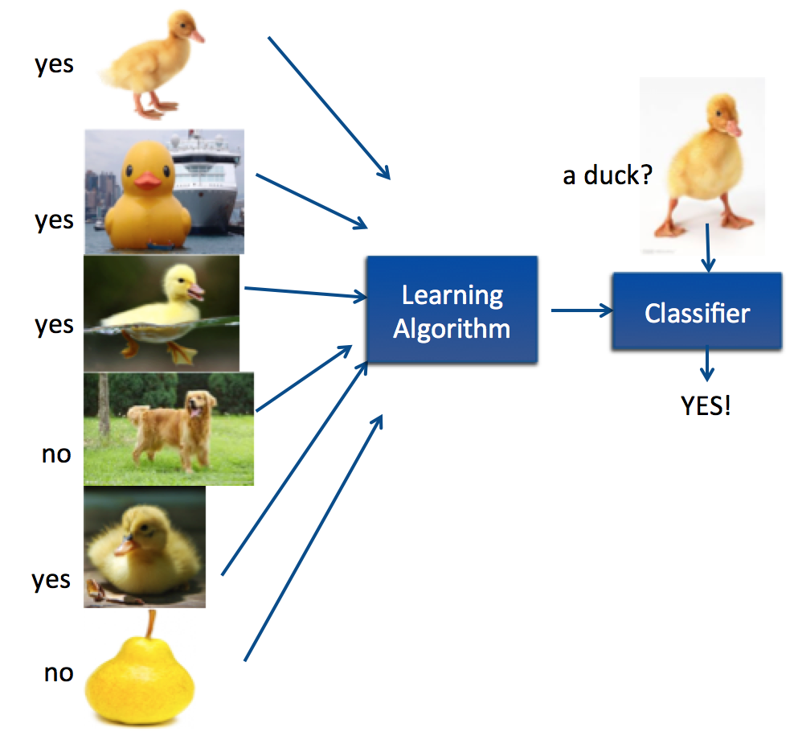
Supervised Learning
A task of inferring a function from labeled training data.
Given a training set of labeled examples {(x₁,y₁), …, (x_{N},y_{N})}, estimate the prediction function f by minimizing the cost.
Then the inferred function f can be used for mapping new examples.
Examples:
Housing price predictions
Spam email classification
Handwriting recognition

Slide 4
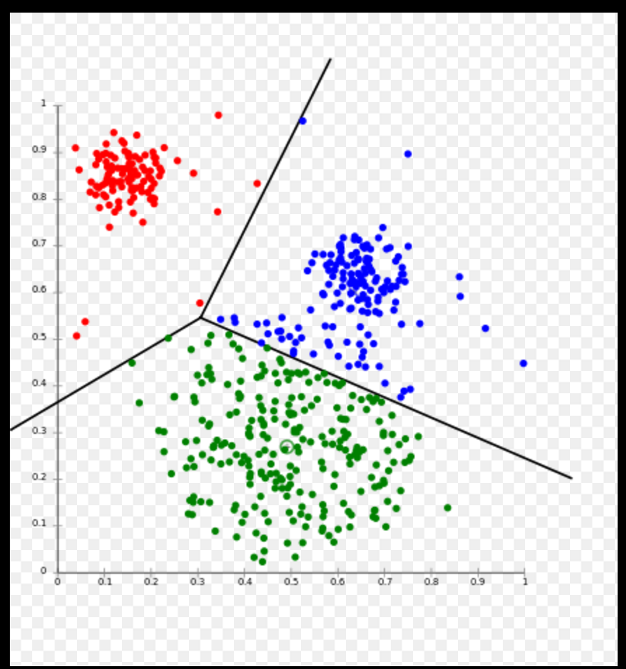
Unsupervised Learning
Used to draw inferences from datasets consisting of input data with unlabeled responses.
Clustering Analysis:
grouping a set of objects in such a way that objects in the same cluster are more similar to each other than to those in other clusters.
Examples:
Market segmentation, anomaly detection,
social network analysis

Slide 5
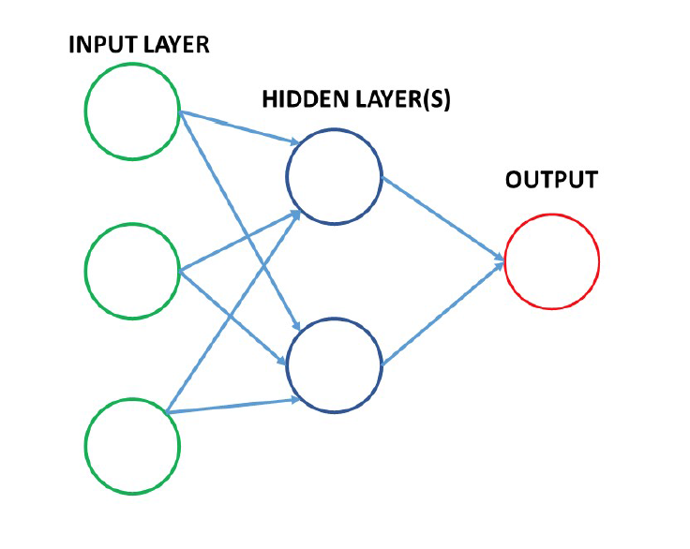
Deep Learning
Deep Learning is a class of machine learning algorithms which:
Mimics the function of the brain with layers of information processing units called artificial neural networks.
Successive layers use the output from previous layers as inputs.
Examples:
Speech recognition
Natural language processing

Slide 6
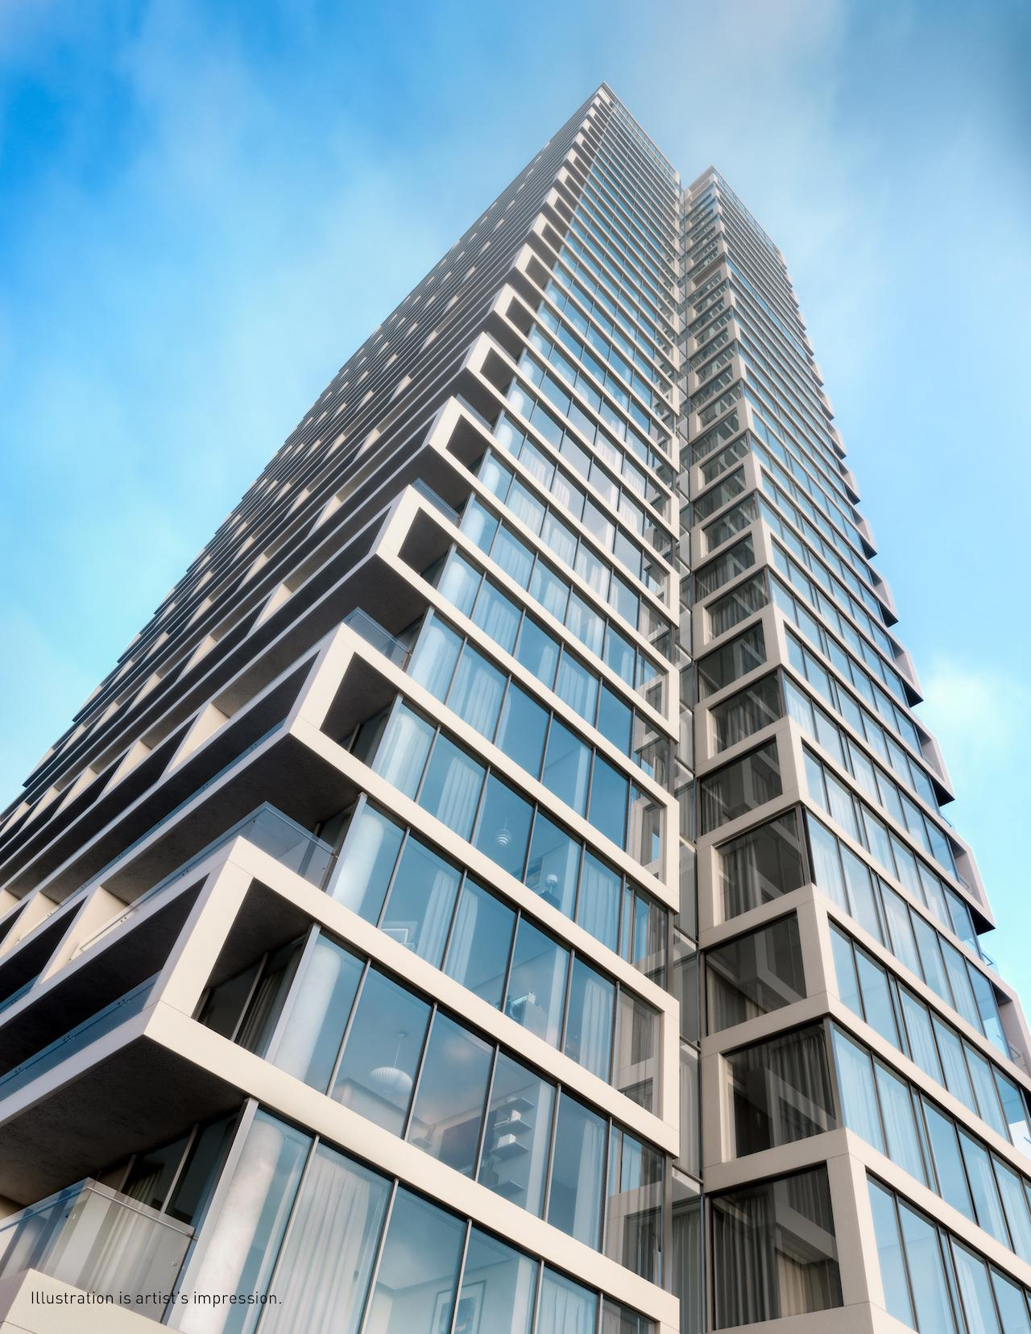
Tridel Data Analytics
Problem Definition
Investigate the crucial and influential features which greatly affect the condominium quality.
Find an effective score function that can be used to measure unit quality as a single scalar.
Design pairwise/listwise comparison models which help to predict the quality rank on any arbitrarily selected condominium units.
Use the above models to test our score function.

Slide 7
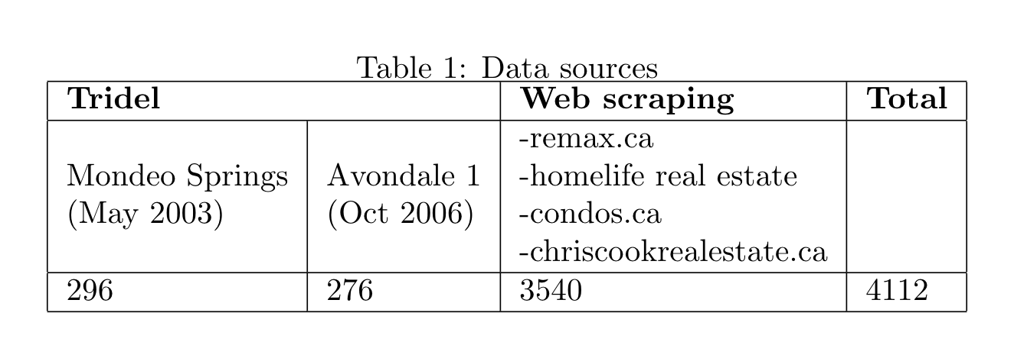
4112 condominium condominium units located in the great Toronto area, from 67/140 different neighbourhoods.
Features:
Housing Characteristics:
Unit size, number of bathrooms, number of bedrooms
Neighbourhood scores:
Crime rate, transit, health, entertainment, community, education, employment, diversity, shopping

Slide 8
Price Predictor
Network Components:
Fully-Connected Layer (FC):
neurons from the previous and current layers are mutually connected
Dropout:
Randomly turn off neurons to prevent over-fitting and enable model ensembles
Network Architecture:
Input -> FC -> Dropout -> FC -> Dropout -> FC -> Dropout -> Output
Critical Factor Analysis :
Influential Features -> more connections & larger weights
-> as score model priors/constraints

Slide 9
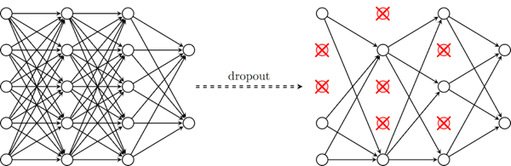
Graphical Representation
Input -> FC -> Dropout -> FC -> Dropout -> FC -> Dropout -> Output
https://cambridgespark.com/content/tutorials/convolutional-neural-networks-with-keras/index.html

Slide 10
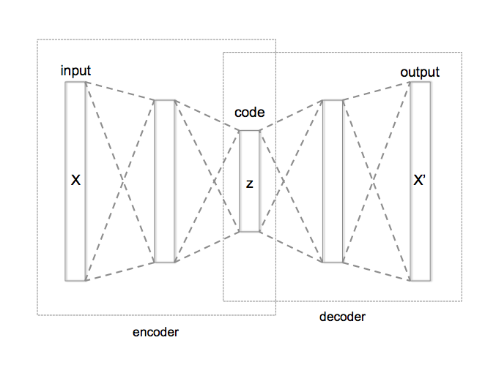
Autoencoder
Mechanism for learning effective inner representations -> lower dimensions
Unsupervised learning -> no need for labels
Easy to extend -> various constraints can be applied
X : Original input
(size, # of rooms,
neighborhood scores)
Z : down-sized representation
(score function)
X’ : up-sized output
(reconstructed input)
https://en.wikipedia.org/wiki/Autoencoder#/media/File:Autoencoder_structure.png

Slide 11
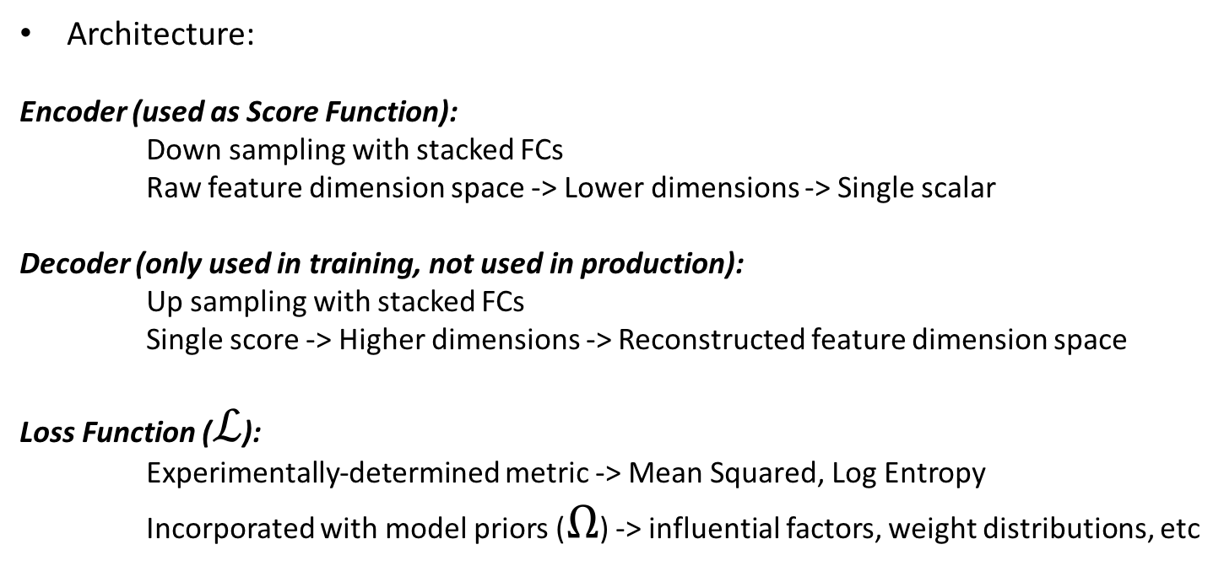
Score Function
Architecture:
Encoder (used as Score Function):
Down sampling with stacked FCs
Raw feature dimension space -> Lower dimensions -> Single scalar
Decoder (only used in training, not used in production):
Up sampling with stacked FCs
Single score -> Higher dimensions -> Reconstructed feature dimension space
Loss Function ($ℒ$):
Experimentally-determined metric -> Mean Squared, Log Entropy
Incorporated with model priors ($Ω$) -> influential factors, weight distributions, etc

Slide 12
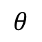
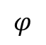
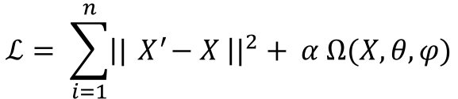
Graphical Representation
$$ℒ= \sum_{i=1}^{n}{{\left||{ X}^{′}−X \right||}^{2}+ α Ω(X,θ, φ)}$$
$$θ$$
$$φ$$
Score Function
Raw Features
Reconstructed
Features

Slide 13
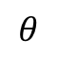
Hierarchical Autodencoder
Number of bedrooms
(raw)
$$θ$$
Number of bathrooms
(raw)
Size of unit
(raw)
Score Function
Neighborhood Score
(composite feature)
Intermediate
layer

Slide 14
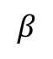
Neighborhood Score
Neighborhood Features
(8 in total)
Entertainment
$$β$$
Transit
Education
…
…
Neighborhood
Score

Slide 15
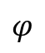
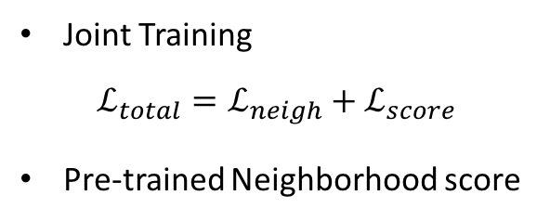
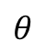
Training
Joint Training
$$ℒ_{total}=ℒ_{neigh}+ℒ_{score}$$
Pre-trained Neighborhood score
…
Neighborhood score
$$θ$$
$$φ$$
Score Function

Slide 16
Usage
Why Score Function ?
Represent individual condo unit quality
Efficient for comparing or ranking candidate units
Provide reference for product pricing

Slide 17
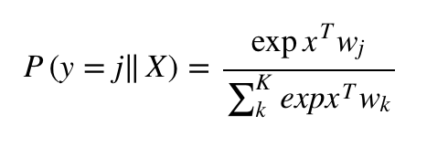
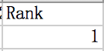
Pairwise comparison model
A simple logistic regression+ deep neural network model that takes raw feature values as inputs and provides binary outputs.
Applied a softmax to render the resulting predictions in the form of probabilities. The output of the Softmax function can be used to represent a categorical distribution, which stands for a probability distribution over 0 and 1.
Label = 1 means that unit1 is priced higher than unit2.
Unit1 has a higher quality.

Slide 18
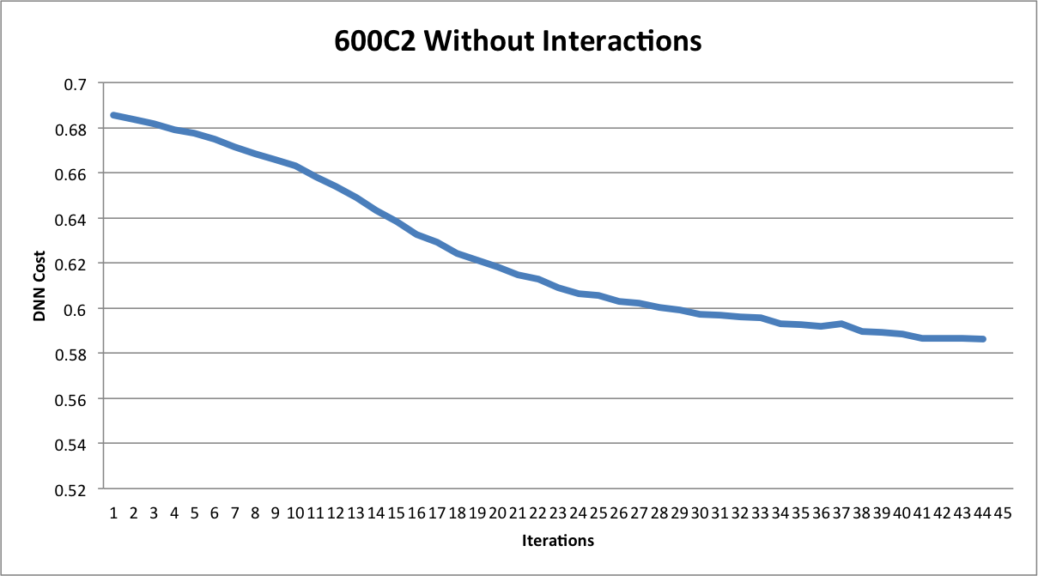
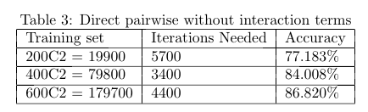
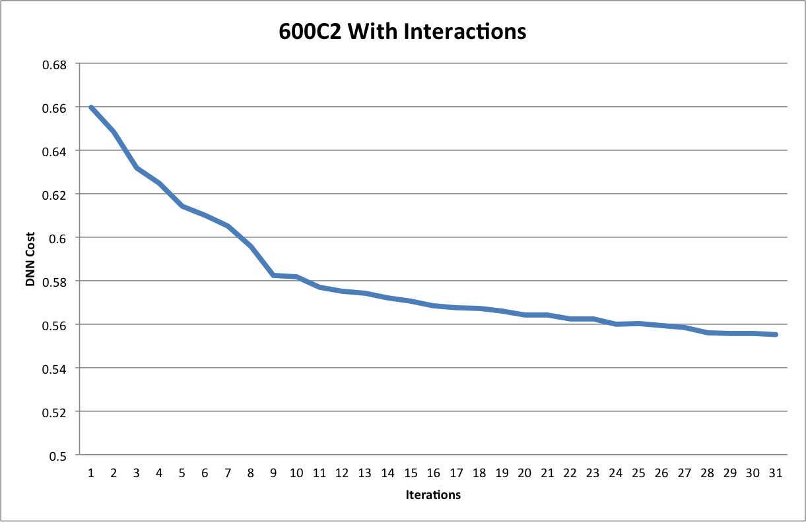
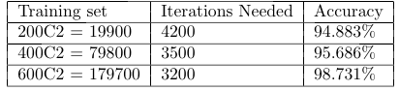
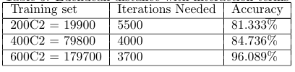
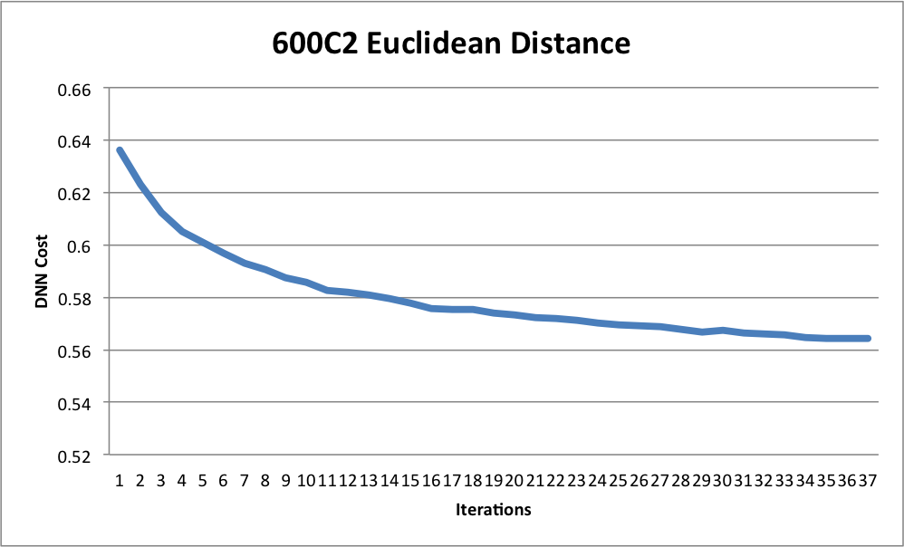
Experiment result
Case1: Direct pairwise comparison without interactions
Case2: Direct pairwise comparison with interactions
Case3: Euclidean distance with interactions

Slide 19
Evaluation
Refine Design
Score
Function
Unit Quality Ranking
Performance
Measures
(Accuracy,
HR@k, etc)
Comparison
Models

Slide 20
Future Work
Complement Comparison Models to enable listwise comparisons
Expand feature set, include historical data (time-series model)
Adapt online training, explore variants of autoencoder

